Slide 1
Getting Started with GIT

Slide 2
Notes
We are just getting going, and we are going to do it in small steps.
We are going to focus on the command line.
what we will learn to day will get you rolling, but is not sufficient for you to work professionally with GIT in a team.
For the time being use the githiub GUI to see changes over time e.g. comparing changes to files over time.

Slide 3
Repositories
A repository is a collection of files that need version control
Repositories can be crudely said to be “public” or ”private”, at least from the GitHub™ perspective.
GIT is a distributed version control tool
GitHub™ is a business, we are just using it as a free tool to get you started with. You can use it to augment your resume.

Slide 4
git and GitHub™ etiquette
Don’t include intellectual property in a public repo. e.g. if you are working the examples from a published e-book, make sure the e-book is not included in your repo (use .gitignore at the very least)
Only include 3rd party material that is appropriately licensed.
Reference any material that you have not generated yourself in your README.md
This is very serious, your employment agreement will have clauses about this form of professional behavior, employers do not tolerate people who can not respect or acknowledge intellectual property in this basic way.

Slide 5
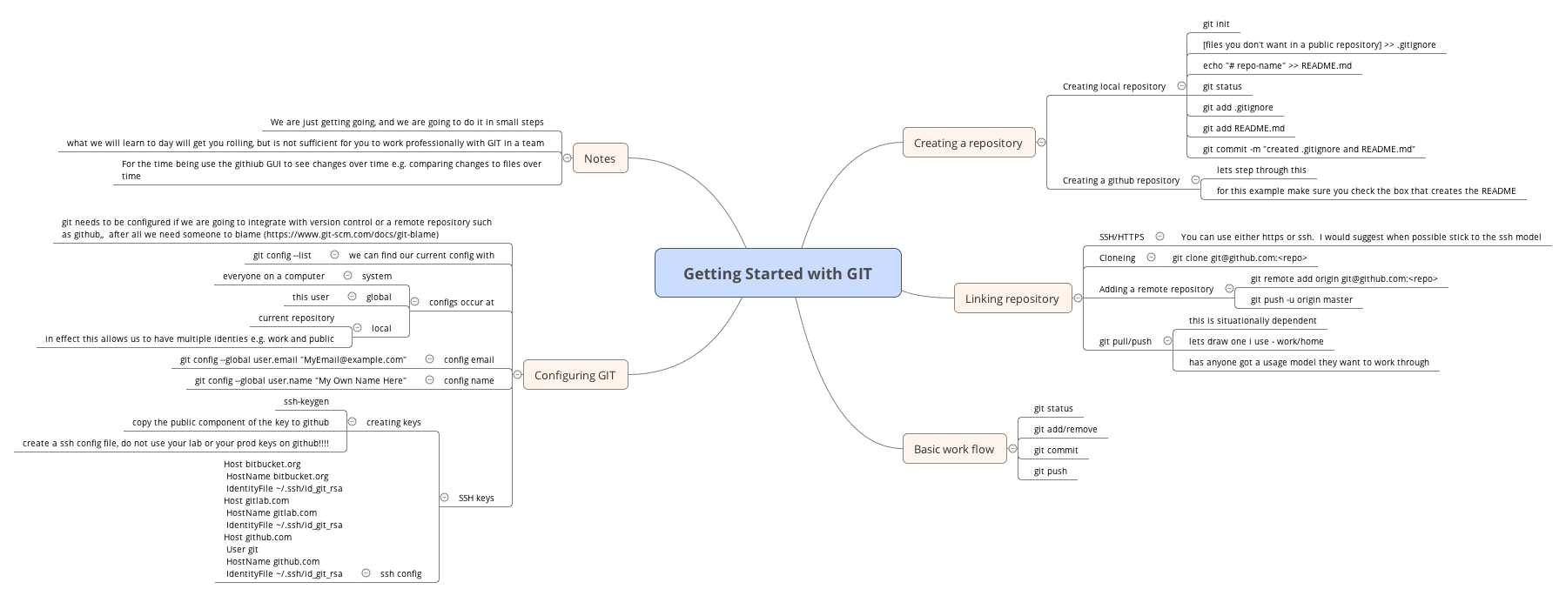
Getting Started with GIT

Slide 6
Configuring GIT
git needs to be configured if we are going to integrate with version control or a remote repository such as GitHub™, after all we need someone to blame. (https://www.git-scm.com/docs/git-blame)
We can find our current config with
  git config –list
Two particular config elements need to be configured before we can link repositories
  config email: git config --global user.email "MyEmail@example.com"
  config name: git config --global user.name "My Own Name Here”
You can also change the default editor, but as you can all use vi you won’t need to.
SSH keys

Slide 7
git config levels
System – everyone on a computer
Global – a user
Local – a repository
In effect this allows us to have multiple identies e.g. work and public for example.

Slide 8
creating SSH keys
We have created ssh keys before (ssh-keygen), but we need to create a git/github/role specific key. Never use your default key.
Create a ssh config file, do not use your lab or your prod keys on GitHub™!!!!
    $ cat ~/.ssh/config
    Host bitbucket.org
    Port 22
Copy the public component of the key to GitHub™
    HostName github.com
    IdentityFile ~/.ssh/id_git_rsa
    HostName bitbucket.org
    IdentityFile ~/.ssh/id_git_rsa
    Host gitlab.com
    HostName gitlab.com
    IdentityFile ~/.ssh/id_git_rsa
    Host github.com
    User git

Slide 9
Creating local repository
$ git init
$ [files you don't want in a public repository] >> .gitignore
$ echo "# repo-name" >> README.md
$ git status
$ git add .gitignore
$ git add README.md
$ git commit -m "created .gitignore and README.md"

Slide 10
Creating a GitHub™ repository
lets step through this
for this example make sure you check the box that creates the README

Slide 11
Linking repository
SSH/HTTPS: You can use either https or ssh. I would suggest when possible stick to the ssh model
Cloning:
  git clone git@github.com:<repo>
Adding a remote repository
  git remote add origin git@github.com:<repo>
  git push -u origin master
git pull/push

Slide 12
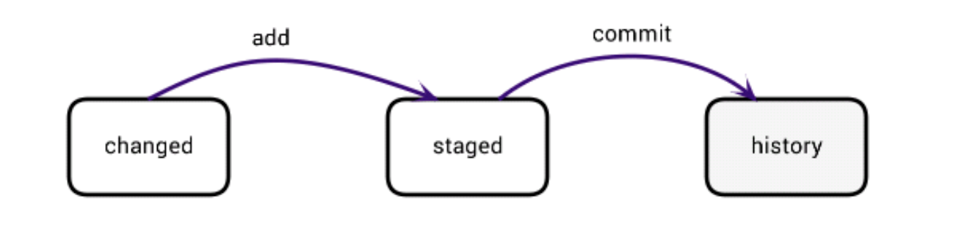
A basic work flow
git status
git add/remove
git commit
git push

Slide 13
Quick Quiz
When is a good time to commit in git?
A) Before you go for lunch
B) When you’ve finished one of the steps towards the feature you’re building
C) When you’ve finished a big feature
D) When you’ve finished a bug fix
E) For every small change

Slide 14
Tasks
Apply this to the HTML and CSS tutorials from internettingishard.com (https://internetingishard.com/html-and-css/)
Apply this to the 3rd edition of “Learn Windows PowerShell in a month of lunches”
Follow kilroy396 on GitHub
Create an avatar for GitHub

Slide 15
Some things to also try..
(make sure you have a commit that includes everything before you start each of these (you only need one!). git is a version control system after all)
Create some non text file types. e.g. a folder, or a .pdf or .png. Include anything you have added in your repo.
  e.g. add a folder called references with (an appropriately licensed) markdown cheat-sheet to your repo. Reference any material that has not been created by yourself in the README.md (it is considered very poor form to misrepresent others work).
Remove a file that you have previously committed to your repo. (Then reintroduce it, via a separate commit)

Slide 16
Some things to also try.. (cont)
Use GitHub™ history to ’recover’ the removed file. (Just do it manually at this stage).
Place one of your previously committed files in your .gitignore; does this automatically remove it from your repo? What do you need to do to ‘remove’ the file. Work the problem. (This is why we have version control).
Go to a computer at home, or create a vm, and setup git. Do a git pull of your repo, make some changes update the local repo and push the changes back to GitHub™. What issues did you encounter? (Don’t forget to then do a pull from your work laptop to assimilate the changes that have been made when you finish).

Slide 17
Using GIT to actually program
Use the GitHub GUI tools for looking at your repo’s versions over time, in the short term.
Try the following for next time:
    $ git log –oneline
    $ git log –stat
The following are contextual, but try this as well:
Command | Notes
git diff | unstaged changes
git diff –staged | changes staged for commit
git diff HEAD | all changes in this directory since the last commit, both staged and not

